Slide 1
Empirical Asset Pricing via Machine Learning
Shihao Gu, Bryan Kelly, Dacheng Xiu
The Review of Financial Studies, vol 33(5), pages 2223-2273.
Long Zhen

Slide 2
Contents
Introduction
Background/Related Literature
Motivation
Research problem
Contribution
Research Design
Data
Method
Empirical Results
Conclusion
Extension

Slide 3
Introduction – Backgrounds
Stock return prediction
Individual stock: Cross-sectional regression Fama and French(2008)
Aggregate portfolio: Time-series regression Goyal and Welch(2008)
Machine learning in empirical asset pricing
Lasso: global equity market returns (Rapach, 2013)
Neural networks: derivatives prices (Hutchinson, 1994 ……), portfolio selection (Heaton, 2016), mortgage payment(Sirignano, 2016)
Regression trees: credit card defaults (Butaru, 2016)
Bootstrap, shrinkage, …

Slide 4
Introduction – Motivation
Traditional methods have severe limitations:
Can’t handle the large number of predictor variables
Introduction – Research Problem
Which method perform better in measuring asset risk premiums?

Slide 5
Introduction – Contribution
Provide a new set of benchmarks for the predictive accuracy in measuring risk premiums
Synthesize the empirical asset pricing literature with the field of machine learning

Slide 6
Methodology
OLS
Elastic Net
PCR
PLS
GLM
Regression trees
Neural networks
Linear Methods
Nonlinear Methods

Slide 7
Methodology
Preliminary step:
Choose hyperparameters via validation
Training sample
Validation sample
Testing sample

Slide 8


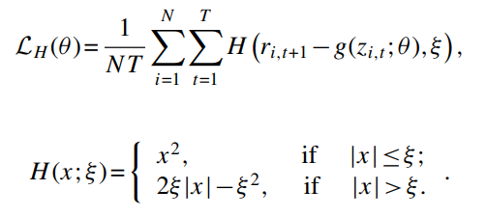
Simple linear(OLS)
→ weighted least squares
tilt estimates toward observations that are more statistically or economically informative
Heavy-tailed observations: Huber robust objective function
a hybrid of squared loss for relatively small errors and absolute loss for relatively large errors
Fail in the presence of many predictors

Slide 9

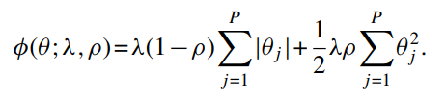
Penalized linear
Elastic Net
ρ =0: absolute value→ lasso (L1) → selection ρ =1: squared value→ ridge regression(L2) → shrinkage
Fail when predictors are highly correlated.

Slide 10
Dimension reduction: PCR and PLS
PCR (principal components regression)
1 Combine regressors into a small set of linear combinations that best preserve the covariance
2 Use leading components in standard predictive regression
PLS(partial least squares)
1 For each predictor j, estimate its univariate return prediction coefficient via OLS (ϕj)
2 Average all predictors into a single aggregate component with weights proportional to ϕj
To form more components, orthogonalize all predictors and target and repeat
Fail to incorporate the forecast step in the dimension reduction step.
Parametric methods can be either mis-specified or overfitting

Slide 11
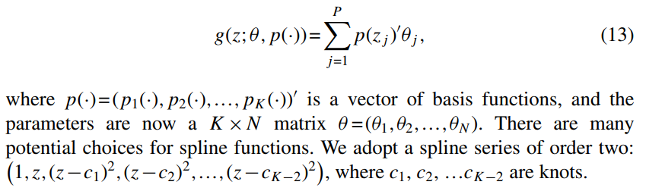
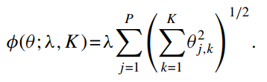
Generalized linear
The most straightforward nonparametric approach
Group lasso

Slide 12
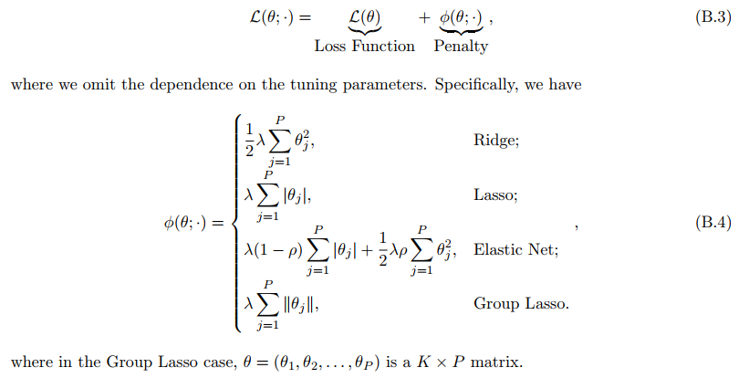
Penalty summary:

Slide 13
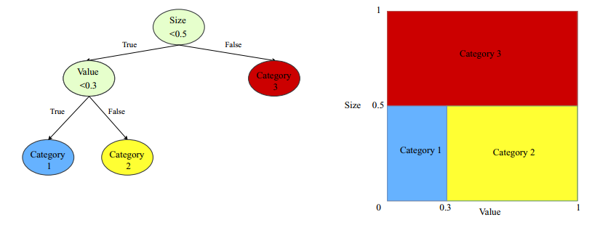
Methodology
Boosted regression trees and random forests
To grow a tree is to find bins that best discriminate among the potential outcomes.
Can approximate severe nonlinearities
Prone to overfit

Slide 14
Methodology
Boosting
At each new step b, a shallow tree is fitted to the residuals from the model with b-1 trees, and its residual forecast is added to the total with a shrinkage weight
Random forest
Bagging: draws B different bootstrap samples of the data, fits a separate regression tree to each
Considers only a randomly drawn subset of predictors for splitting at each potential branch.

Slide 15
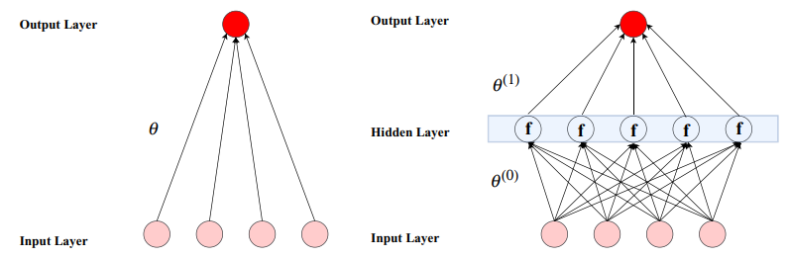
Neural networks
Hyperparameters
NN1(32); NN2(32,16); NN3(32,16,8); NN4(32,16,8,4); NN5(32,16,8,4,2) → geometric pyramid rule
Linear regression model

Slide 16

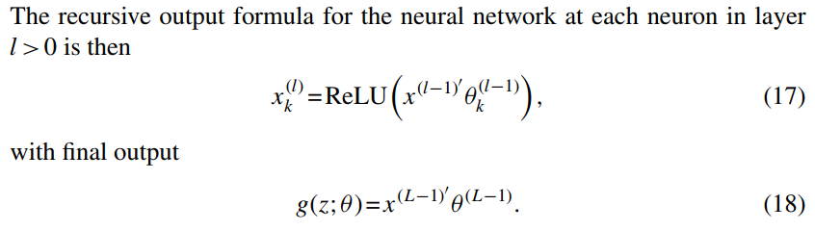
Activation function:
Optimization: stochastic gradient descent(SGD)
Regularization:
learning rate shrinkage;
early stopping;
batch normalization;
ensemble

Slide 17
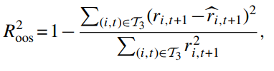
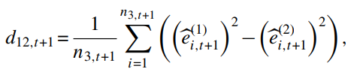

Methodology
Performance evaluation
Pairwise comparison
Testing subsample
Without demean:
Benchmark against zero

Slide 18

Methodology
Variable importance and marginal relationships
the reduction in panel predictive R2 from setting all values of predictor j to zero, while holding the remaining model estimates fixed
the sum of squared partial derivatives (SSD) summarizes the sensitivity of model fits to changes in that variable.

Slide 19
Research Design
Individual stock returns
30 Aggregate portfolio returns
Machine learning portfolios
Predict one-month-ahead stock return
Sort them into deciles
Long the highest and short the lowest

Slide 20

Research Design – Data
CRSP
1957.3 ~ 2016.12:
18 years of training sample (1957–1974)
12 years of validation sample (1975–1986)
30 years (1987–2016) for out-of-sample testing.
94 characteristics + 74 industry dummies + 8 macro

Slide 21
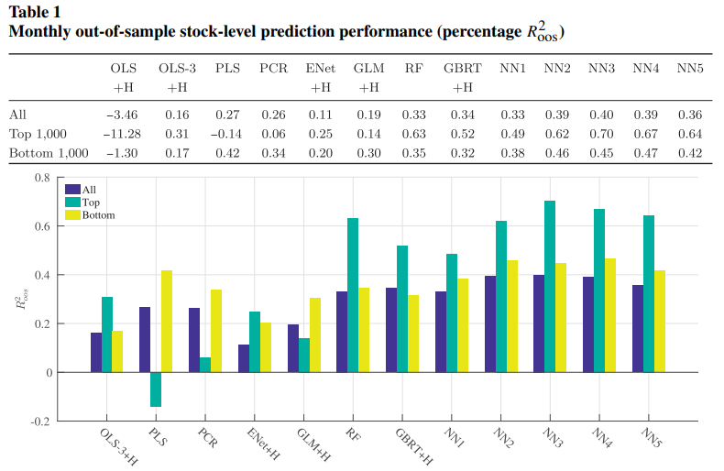
Empirical Results

Slide 22
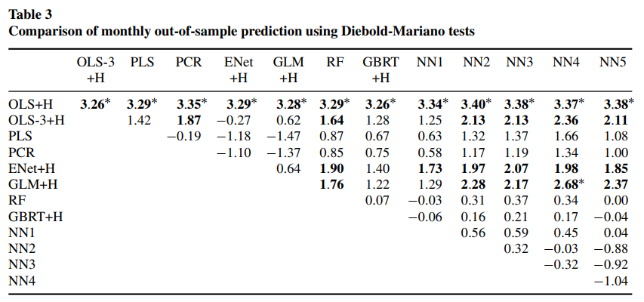
Empirical Results

Slide 23
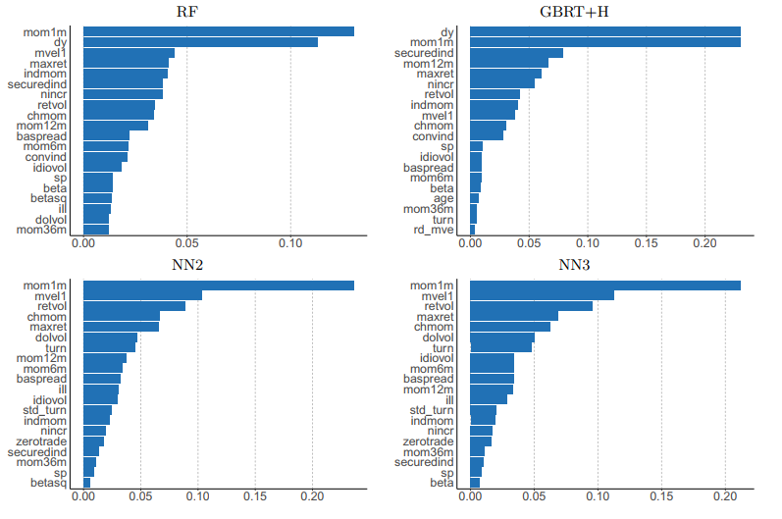
Empirical Results
Figure 4 Variable importance by mode

Slide 24
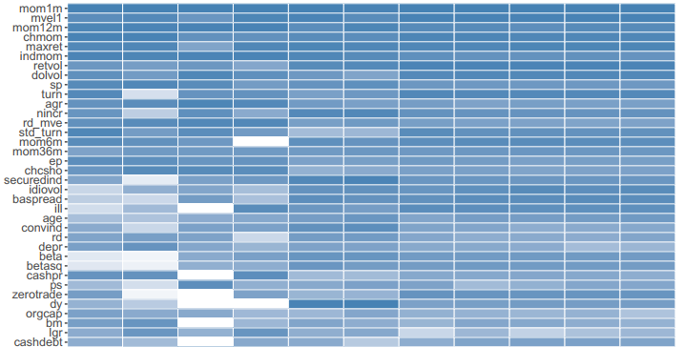
Empirical Results
momentum and reversal

Slide 25
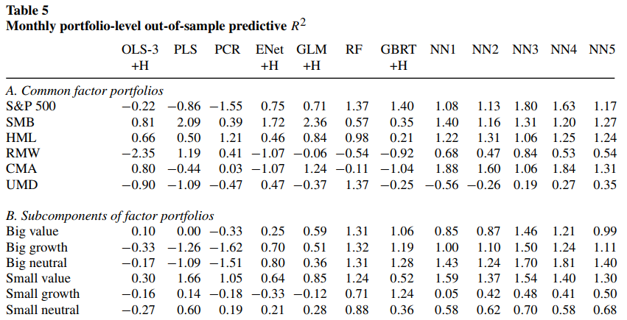
Empirical Results

Slide 26
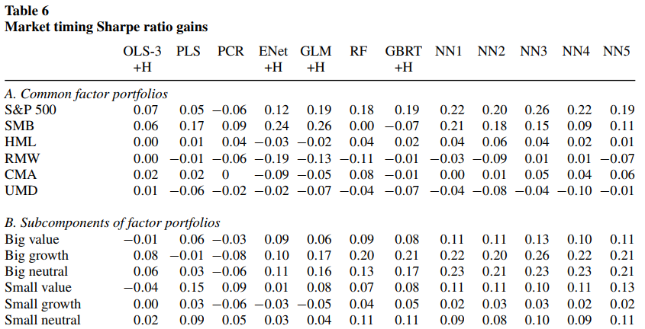
Empirical Results

Slide 27
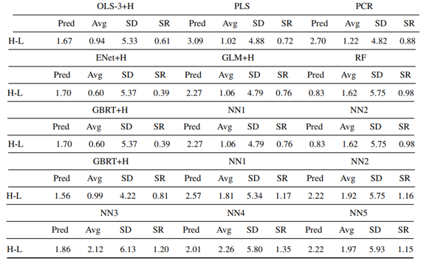
Empirical Results
Table 7 Performance of the machine learning portfolios

Slide 28
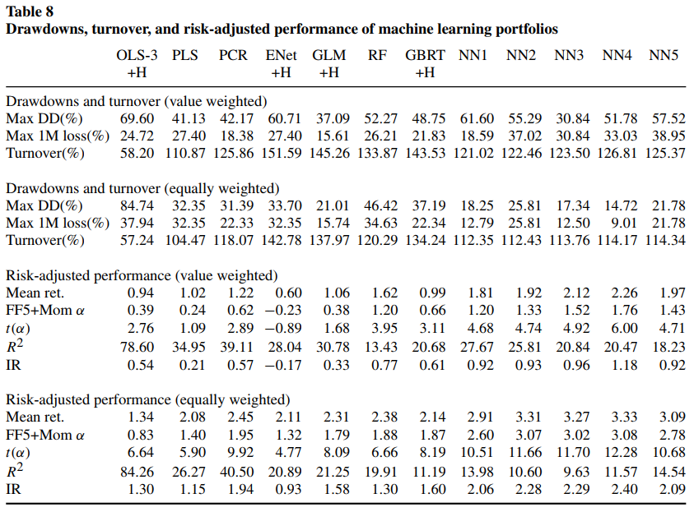
Empirical Results

Slide 29
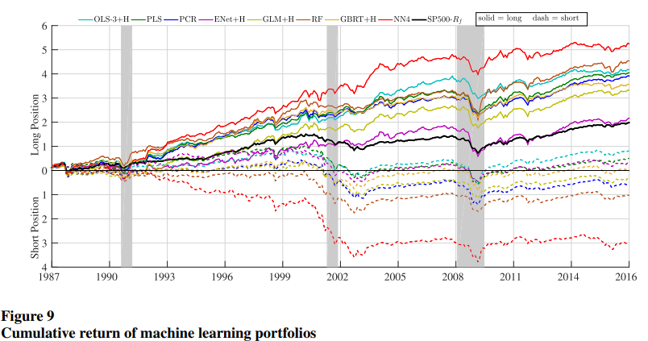
Empirical Results

Slide 30
Conclusion
machine learning methods(neural network, regression trees) can help improve our empirical understanding of asset prices.
“shallow” learning outperforms “deep” learning
Machine learning methods are most valuable for forecasting larger and more liquid stock returns and portfolios.
The most powerful predictors being associated with price, stock liquidity, stock volatility, and valuation ratios

Slide 31
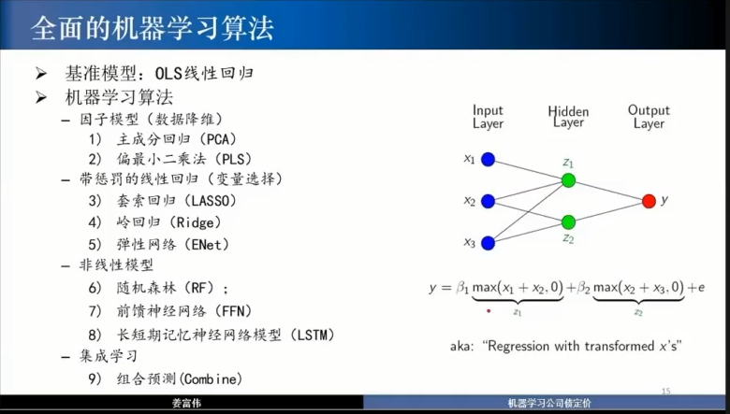
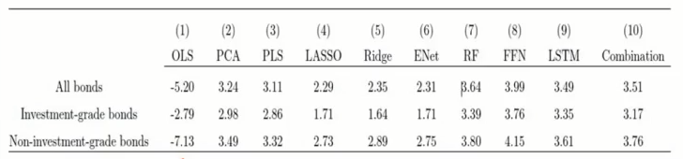
Extension： 姜富伟《基于大数据和机器学习的公司债定价》

